Slide 1
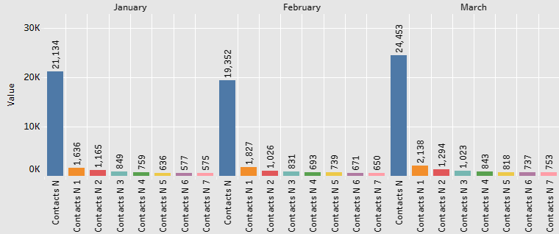
Google Fiber Project Executive Summary
Overview
This project seeks to understand Google Fiber’s call trends and devise a BI solution to reduce repeated caller volumes, improve operational optimization and thereby, improve customer experience.
The Problem
Google Fiber customers are calling the customer service multiples times which alludes to their issues being not resolved the first time. The stakeholders want to understand
explore trends in repeat call and find answers to some key business questions:
How often do the customers call the customer support after their first inquiry?
Why are the customers having to call more than once?
The Solution
The Google Fiber BI team has built a Tableau Dashboard based on the stakeholder requirements that will help stakeholders to address these concerns and find out what metrics shall help them achieve their end-goals.
Details
Keys to success
Data merging should be appropriately implemented for all market cities.
The stakeholder expectations must reflect into the project strategies for building the right charts.
Dashboard must be intuitive, accessible, dynamic and address all the business problems to which the stakeholders need solutions for.
Monthly Repeated Calls from Day 0 to Day 7
Results Summary
It was identified that Day 1 repeaters have the highest repeat frequency and tend to be generally during the weekdays. The highest repeated calls in Market-1 of problem Type-2. Type-2 is also the most common problem in Market-2 and Market-3 as well. Hence, resolving Type-2 shall enable customer retention in all three Market cities.
Reflections/
Next Steps
The project enabled the BI team to explore caller trends based on categorical distributions and identify the most affected Market and what type of problems.
The Dashboard is iterative and is accomodative of any further improvements or additions should the stakeholders needs change.
As a next step, once the customer service team has implemented solutions based on BI team’s dashboard, the future metrics can be compared with the current metrics and gauge the effectiveness of the solutions in reducing caller frequencies.

